Slide 1

Knowledge Gradient for Constrained Problems
https://emruur.github.io/BOLeiden/
Group 8

Slide 2
Regular Acquisition Functions
Knowledge Gradient
Aim to find the maximum in a single step
Do not capture the value of the information gained from sampling a solution
Where is the maximum of our function?
Sampling at a point provides some information to later time steps
Simulates a one step lookahead from our sampling point
If I sample next at point x what’s the expected increase in my best predicted value after updating the GP?

Slide 3
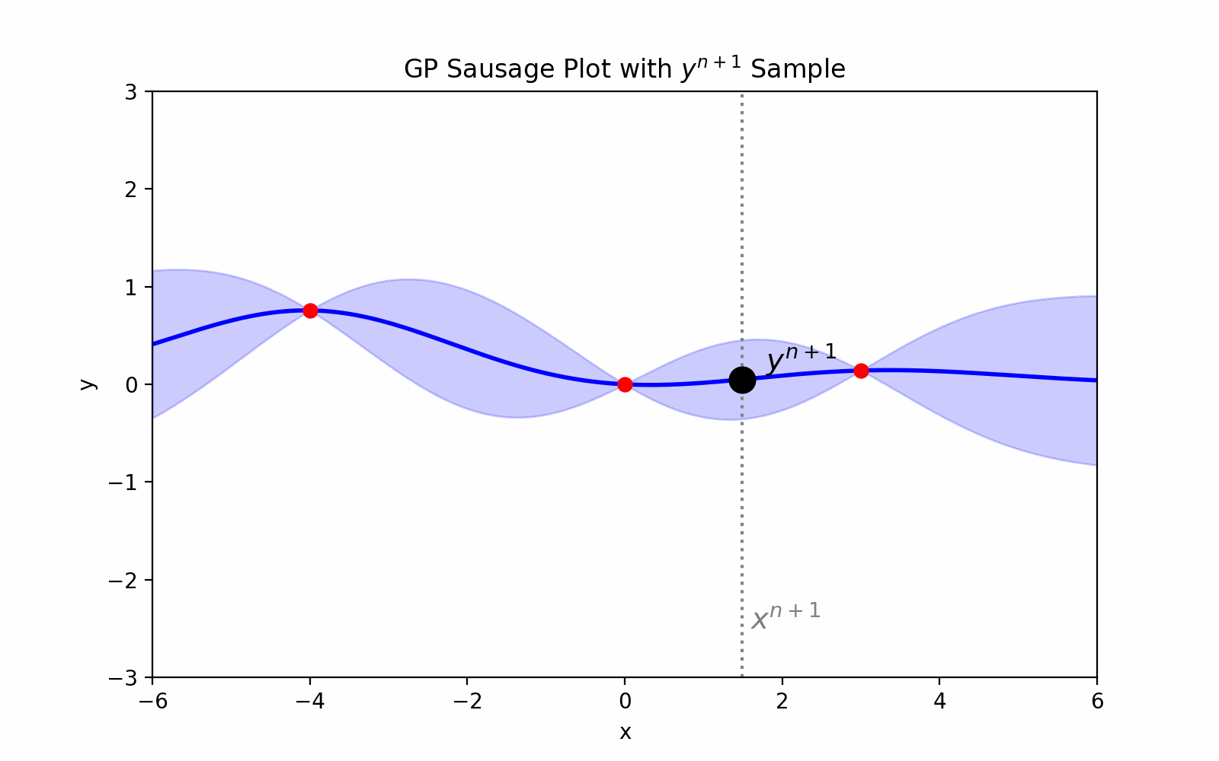
Formal Definition
According to our GP we may have many realizations of $y^{n+1}$
The maximum of the old posterior
$$KG(x)=E\left[\max_{x^{′′}∈X}\{μ_{y}^{n+1}(x^{′′})\}-\max_{x^{′}∈X}\{μ_{y}^{n}(x^{′})\}|x^{n+1}=x\right].$$
The maximum of the new posterior after getting updated with $y^{n+1}$
Lets hypothise that we sample at x

Slide 4
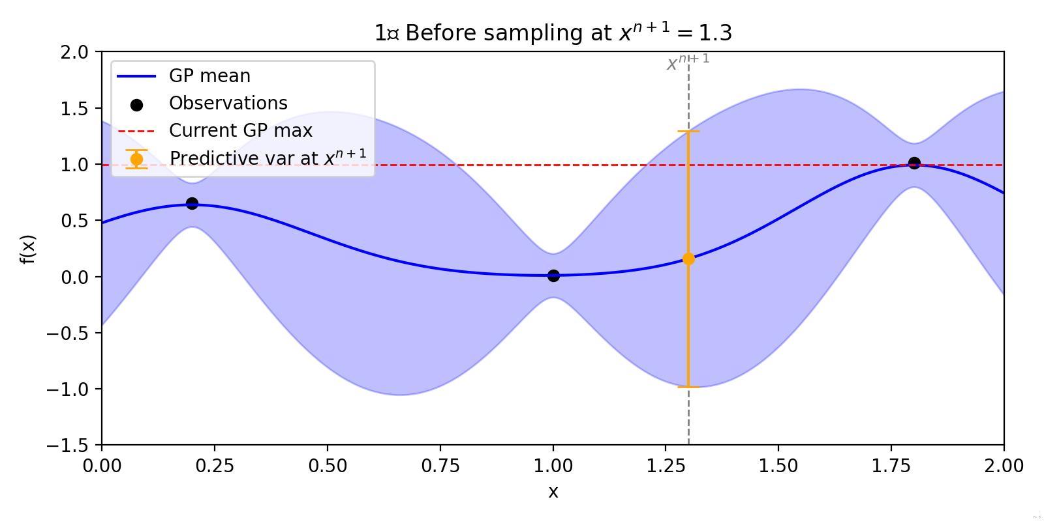
Monte Carlo Sampling - 1
WuandFrazier2017

Slide 5
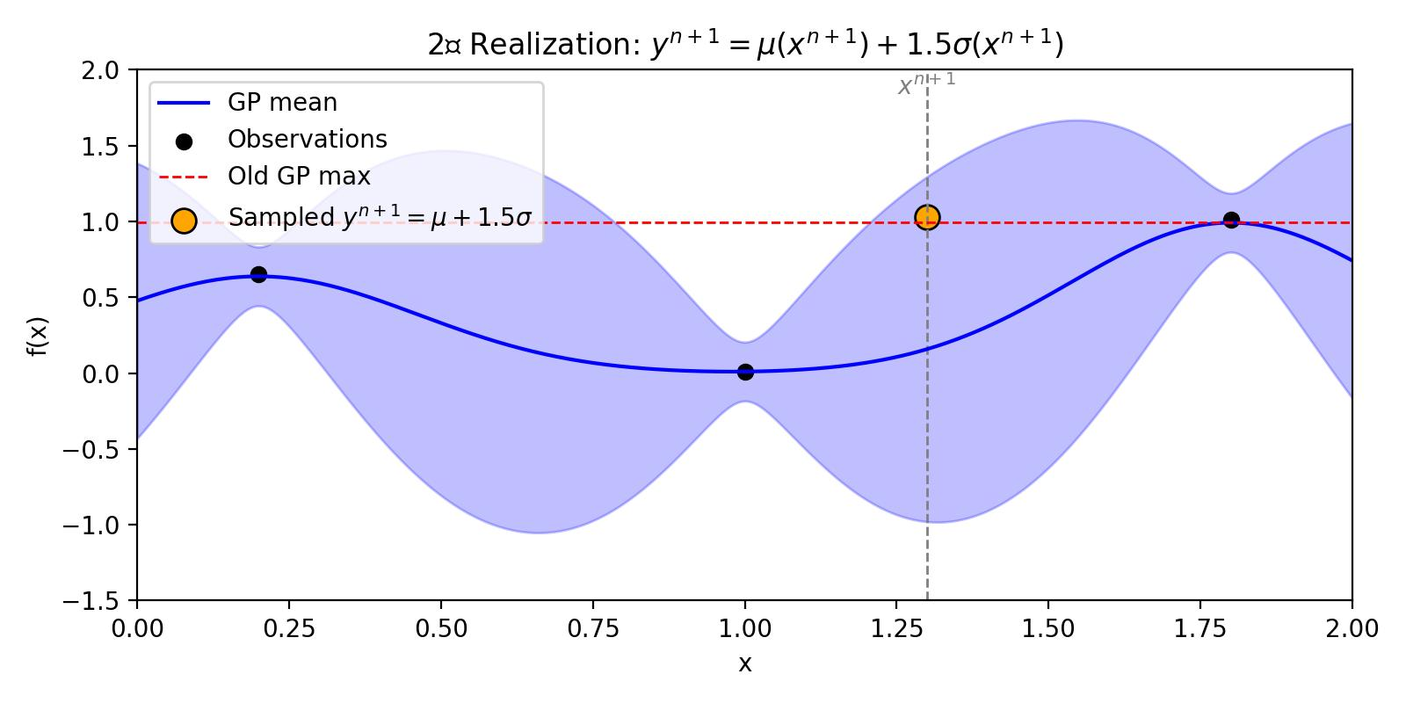
Monte Carlo Sampling - 2
WuandFrazier2017

Slide 6
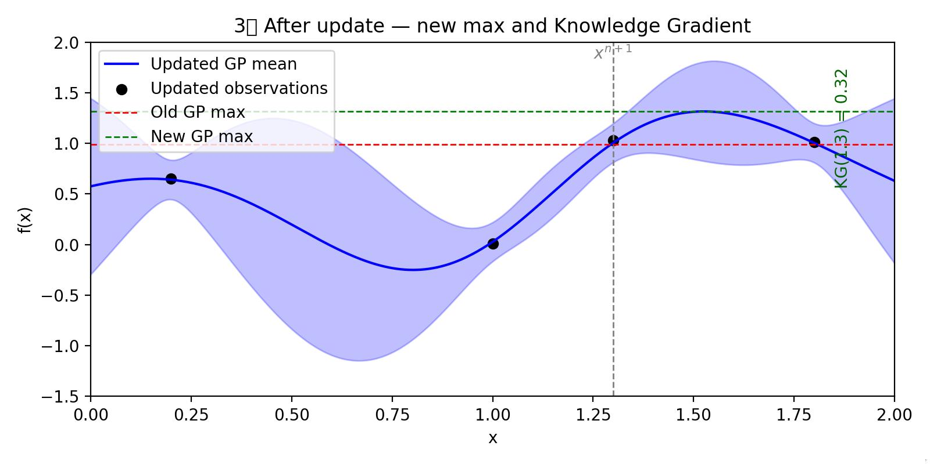
Monte Carlo Sampling - 3
WuandFrazier2017

Slide 7
Reparameterization Trick
Reparameterization expresses the new GP mean with the included $x^{n+1}$ data point $μ_{y}^{n+1}(x)$ using the old GP mean $μ_{y}^{n}(x)$
$$μ_{y}^{n+1}(x)=μ_{y}^{n}(x)+{\overset{˜}{σ}}_{y}^{n}(x,x^{n+1})Z_{y},Z_{y}∼N(0,1),$$
Intoducess randomness to GP posterior sampling
Reparameterized covariance coefficient of x, $x^{n+1}$
$${\overset{˜}{σ}}_{y}^{n}(x,x^{n+1})=\frac{k_{y}^{n}(x,x^{n+1})}{\sqrt{k_{y}^{n}(x^{n+1},x^{n+1})+σ_{ϵ}^{2}}}$$
Notice the new posterior mean is a linear function of $Z_{y}$

Slide 8
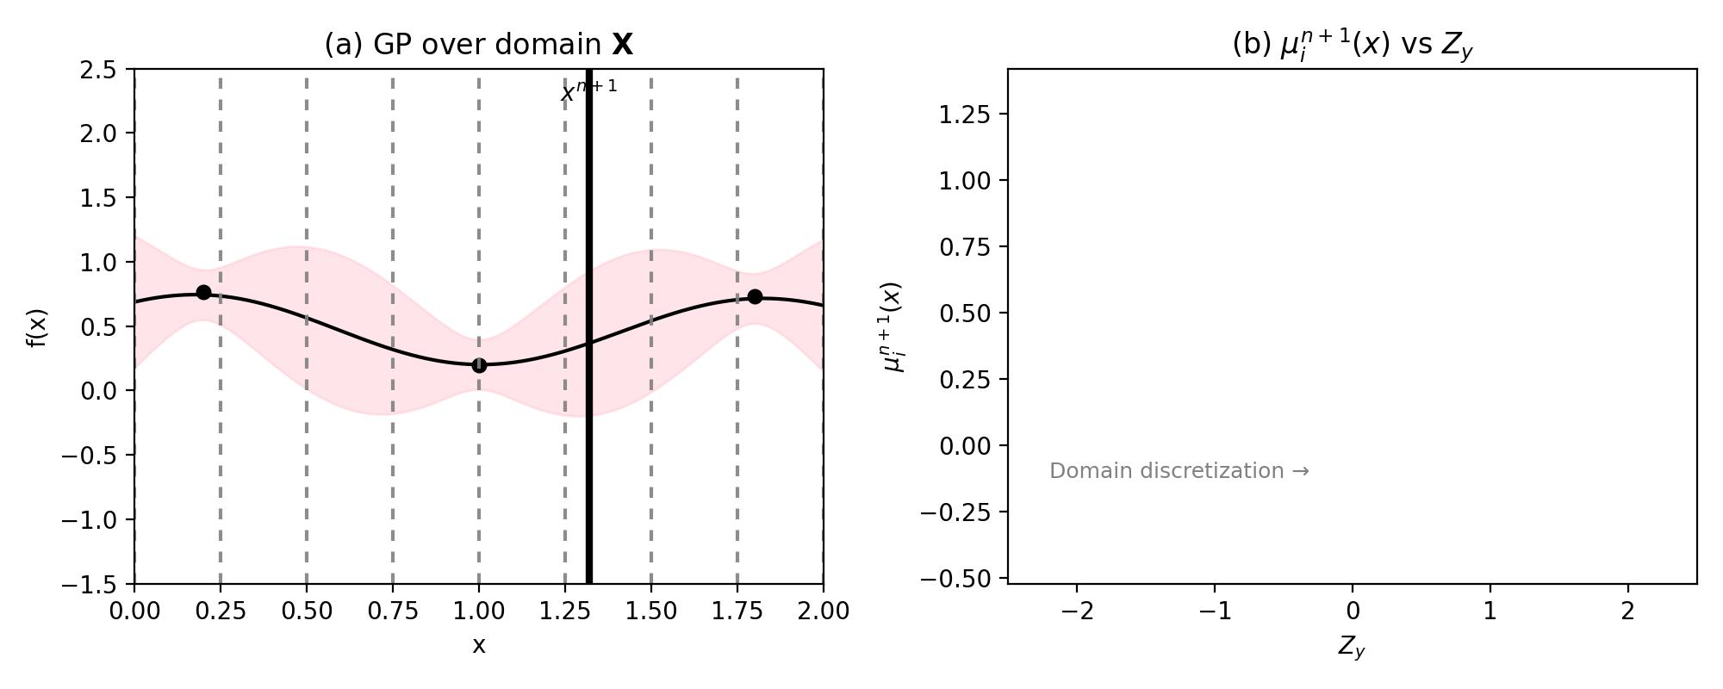
Discretization and Linear-Envelope - 1
Scott et al 2011
The domain X is discretized into a finite set $X_{j}$ $\{x_{1},x_{2},…,x_{J}\}$

Slide 9
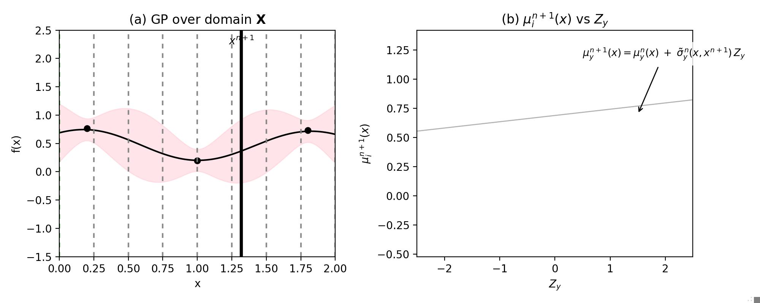
Discretization and Linear-Envelope - 2
Scott et al 2011
For each discrete point $x_{j}$, an updated posterior mean formulation is obtained using the reparameterization trick

Slide 10
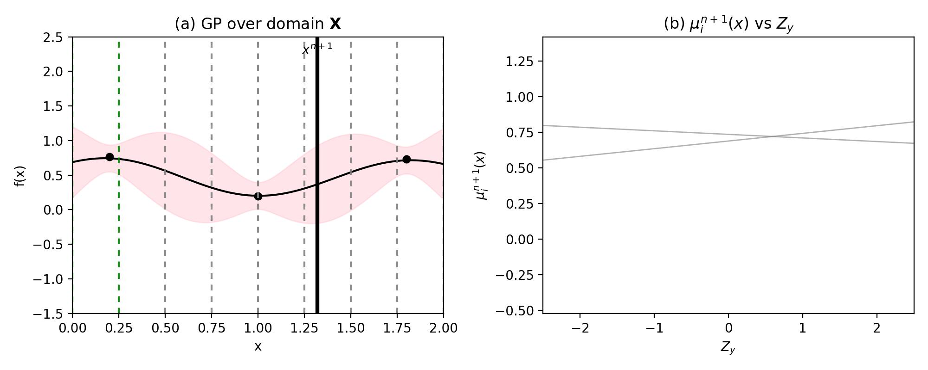
Discretization and Linear-Envelope - 3
Scott et al 2011
For each discrete point $x_{j}$, an updated posterior mean formulation is obtained using the reparameterization trick

Slide 11
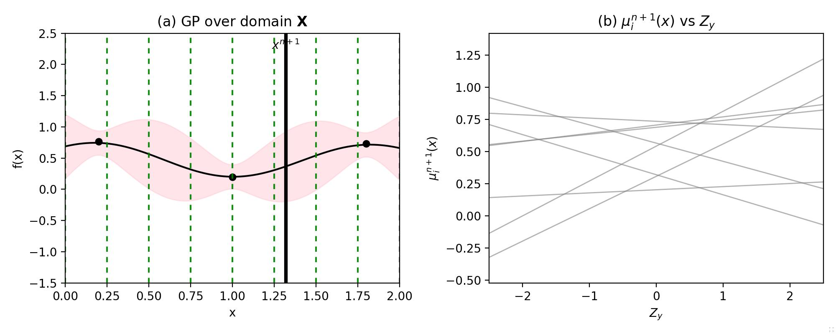
Discretization and Linear-Envelope - 4
Scott et al 2011
We have obtained linear expressions that describe the updated posterior mean $μ_{y}^{n+1}(x_{j})$ at every discrete point.

Slide 12
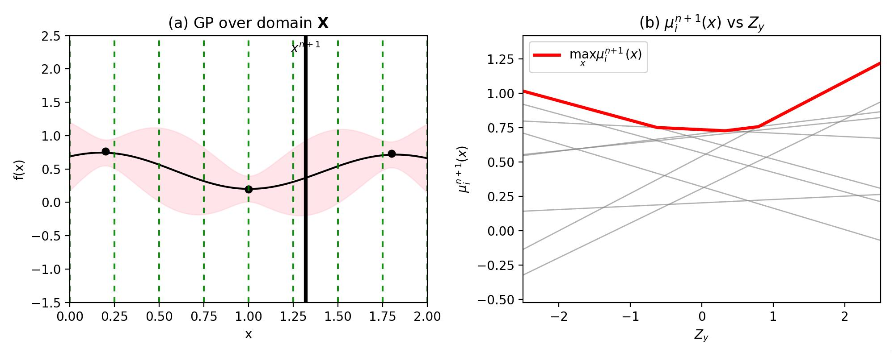
Discretization and Linear-Envelope -5
Scott et al 2011
Taking the maximum of these linear functions yields a piecewise-linear envelope representing$\max_{x^{′}∈X_{d}}\{μ_{y}^{n+1}(x^{′})\}$

Slide 13
Discretization and Linear-Envelope -6
Scott et al 2011
The linear envolope$\max_{x^{′}∈X_{d}}\{μ_{y}^{n+1}(x^{′})\}$ is parametirized by $Z_{y}$ which is the probability of that maximum happening.
We can integrate this linear envolope with respect to $Z_{y}$ to obtain $E_{Z_{y}}\left[\max_{x^{′}∈X_{d}}\{μ_{y}^{n+1}(x^{′})\}\right].$
Above quantity allows us to compute KG since the max of the old posterior can be taken out of the expectation. $KG(x)=E\left[\max_{x^{′′}∈X}\{μ_{y}^{n+1}(x^{′′})\}|x^{n+1}=x\right]-\max_{x^{′}∈X}\{μ_{y}^{n}(x^{′})\}.$

Slide 14
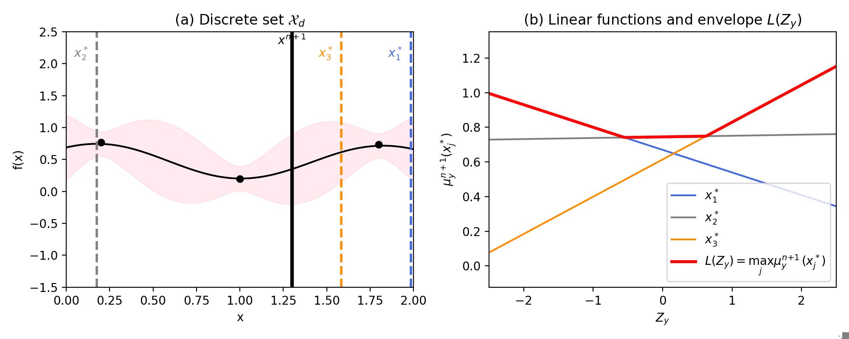
High Value Linear Envelope - 1
Pearce et al. [2020]
Fixed discretization grows with number of dimensions
Many of the points don’t contribute to the max
Pearce et al. propose a different way of discretazing the domain where all discretization points contribute to the max and number of points don’t grow with number of dimensions

Slide 15
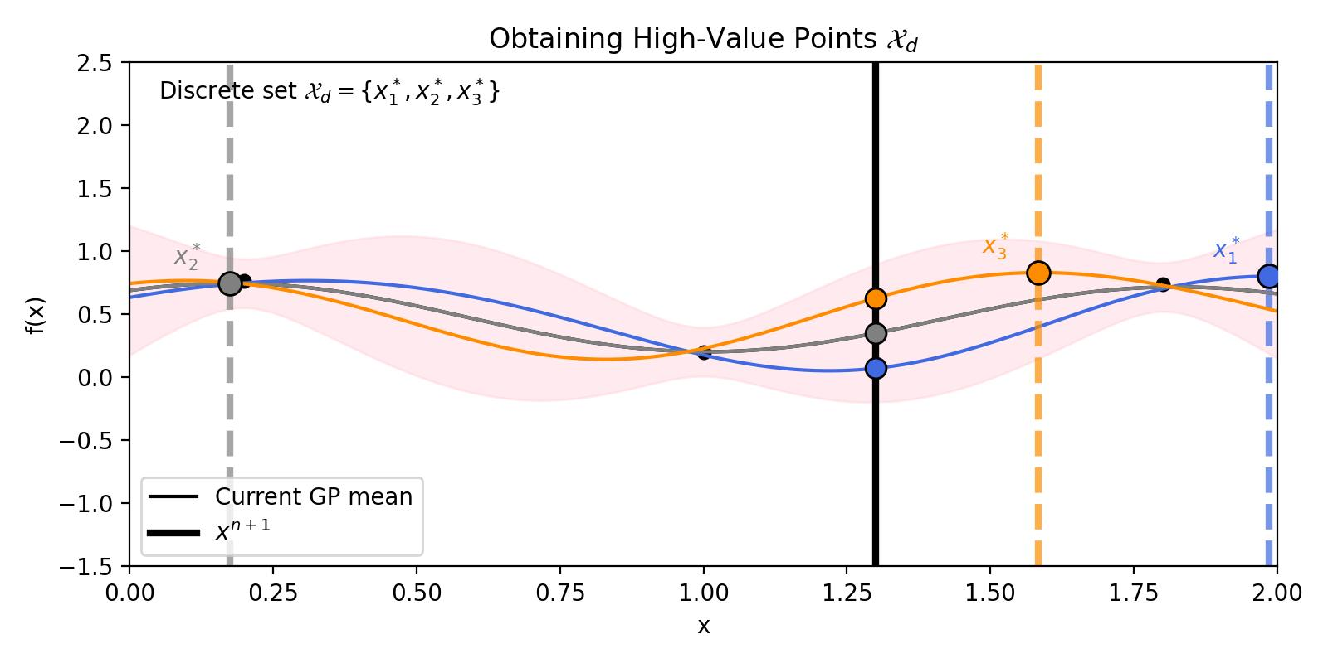
High Value Linear Envelope - 2
Pearce et al. [2020]
Select a few quantiles of the standard normal variable $Z_{y}$, for example $Z_{y}∈\{-1,0,1\}$. These correspond to possible realizations of the future observation $y^{n+1}$
For each sampled value of $Z_{y}$, update the GP posterior and obtain the point $x_{j}$ that maximizes this updated mean

Slide 16
High Value Linear Envelope - 3
Pearce et al. [2020]
Continue with Scott et al. (2011) using the scenario-driven discrete set $X_{d}$:

Slide 17
Constrained BO Definition
$$x^{*}=arg\max_{x∈X}f(x)\text{s.t.}c_{k}(x)≤0,k=1,…,K.$$
Both the objective $f(x)$ and the constraints $c_{k}(x)$ are modeled as independent Gaussian Processes (GPs). At iteration $n$, their posteriors are described by their respective means and variances:
$$μ_{y}^{n}(x),σ_{y}^{n}(x)\text{for the objective, and}μ_{c_{k}}^{n}(x),σ_{c_{k}}^{n}(x)\text{for each constraint.}$$

Slide 18
Probability of Feasibility (PF)
The probability of feasibility for a candidate design $x$is defined as the probability that all constraints are satisfied under the current GP models:
$${\text{PF}}^{n}(x)=\overset{K}{\underset{k=1}{∏}}P(c_{k}(x)≤0)=\overset{K}{\underset{k=1}{∏}}Φ\left(-\frac{μ_{c_{k}}^{n}(x)}{σ_{c_{k}}^{n}(x)}\right),$$
The penalized posterior mean— the GP mean of the objective scaled by the probability of feasibility:
$$x_{r}^{n}=arg\max_{x∈X}μ_{y}^{n}(x){\text{PF}}^{n}(x).$$

Slide 19
Constrained Knowledge Gradient (cKG) -1
The penalized posterior mean at timestep n+1 is evaluated at the point that maximizes the penalized posterior at timestep n
n
n.
$$\text{cKG}(x)=E\left[\max_{x^{′}∈X}\{μ_{y}^{n+1}(x^{′}){\text{PF}}^{n+1}(x^{′})\}-μ_{y}^{n}(x_{r}^{n}){\text{PF}}^{n+1}(x_{r}^{n})|x^{n+1}=x\right].$$
The maximum of the new penalized posterior mean after getting updated with $y^{n+1}$

Slide 20
Constrained Knowledge Gradient (cKG) - 2
Recall the reparametrization trick
$$y(x)=μ_{y}^{n}(x)+{\overset{˜}{σ}}_{y}(x,x^{n+1})Z_{y},Z_{y}∼N(0,1)$$
$$c(x)=μ_{c}^{n}(x)+{\overset{˜}{σ}}_{c}(x,x^{n+1})Z_{c},Z_{c}∼N(0,I)$$
$${PF}^{n+1}(x;x^{n+1},Z_{c})=Pr[c_{j}(x)≤0∀j|Z_{c},D^{n+1}].$$
The maximum of the penalized posterior mean after getting updated with $y^{n+1}$
$$cKG(x)=E_{Z_{c},Z_{y}}\left[\max_{x^{′}∈X}\{(μ_{y}^{n}(x^{′})+{\overset{˜}{σ}}_{y}(x^{′},x^{n+1})Z_{y}){PF}^{n+1}(x^{′};x^{n+1},Z_{c})\}-μ_{y}^{n}(x_{r}){PF}^{n+1}(x_{r}^{n};x^{n+1},Z_{c})|x^{n+1}=x\right].$$
Posterior mean at timestep n+1 determined by $Z_{y}$
The penalized posterior mean at timestep n+1 is evaluated at the point that maximizes the penalized posterior at timestep n. Determined by $Z_{c}$
n
n.
Probabilty of feasability at timestep n+1 determined by $Z_{c}$

Slide 21
How to Compute ???
$$cKG(x)=E_{Z_{c},Z_{y}}\left[\max_{x^{′}∈X}\{(μ_{y}^{n}(x^{′})+{\overset{˜}{σ}}_{y}(x^{′},x^{n+1})Z_{y}){PF}^{n+1}(x^{′};x^{n+1},Z_{c})\}-μ_{y}^{n}(x_{r}){PF}^{n+1}(x_{r}^{n};x^{n+1},Z_{c})|x^{n+1}=x\right]$$
Condition(fix) on $Z_{c}$
$$cKG(x)=E_{Z_{c}}\left[E_{Z_{y}}\left[\max_{x^{′}∈X}\left\{\left[μ_{y}^{n}(x^{′})+{\overset{˜}{σ}}_{y}(x^{′},x^{n+1})Z_{y}\right]{PF}^{n+1}(x^{′};x^{n+1},Z_{c})\right\}-μ_{y}^{n}(x_{r}){PF}^{n+1}(x_{r}^{n};x^{n+1},Z_{c})|x^{n+1}=x,Z_{c}\right]\right]$$
Since $Z_{c}$ is fixed, we can compute this using the high value linear envelope method Pearce et al. [2020]
Generate a discrete set $X_{d}$ using the high value estimates
Obtain a piecewise linear function for $max_{x∈X}μ_{y}^{n+1}(x){\text{PF}}^{n+1}(x;Z_{c})$
Integrate w.r.t $Z_{y}$ to obtain $E_{Z_{y}}\left[\max_{x^{′}∈X}\left\{(μ_{y}^{n}(x^{′})+{\overset{˜}{σ}}_{y}(x^{′},x^{n+1})Z_{y}){PF}^{n+1}(x^{′};x^{n+1},Z_{c})\right\}|x^{n+1}=x,Z_{c}\right]$
${KG}_{d}(x^{n+1}=x;Z_{c}^{m})$
$$cKG(x)=\frac{1}{n_{c}}\overset{n_{c}}{\underset{m=1}{∑}}{KG}_{d}(x^{n+1}=x;Z_{c}^{m}).$$

Slide 22
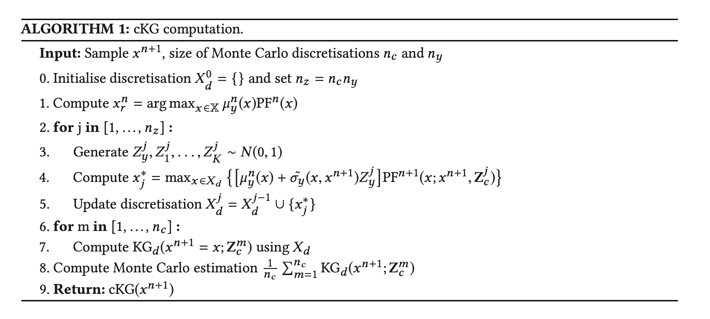
Pseudocode

Slide 23
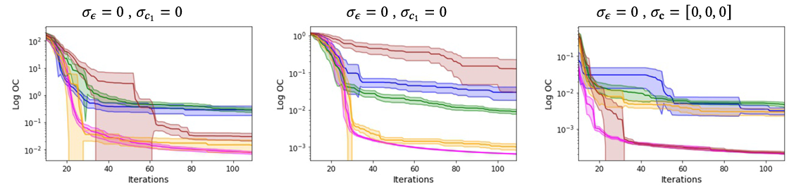
Performance in Deterministic Setting

Slide 24
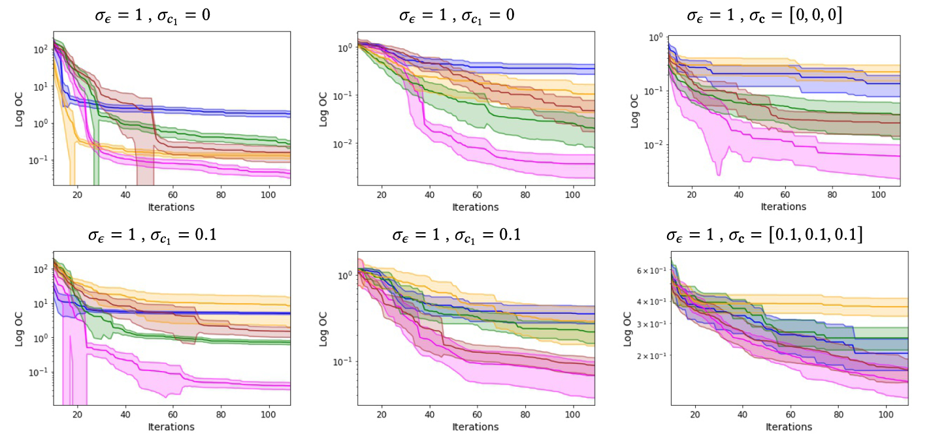
Performance Under Noise

Slide 25
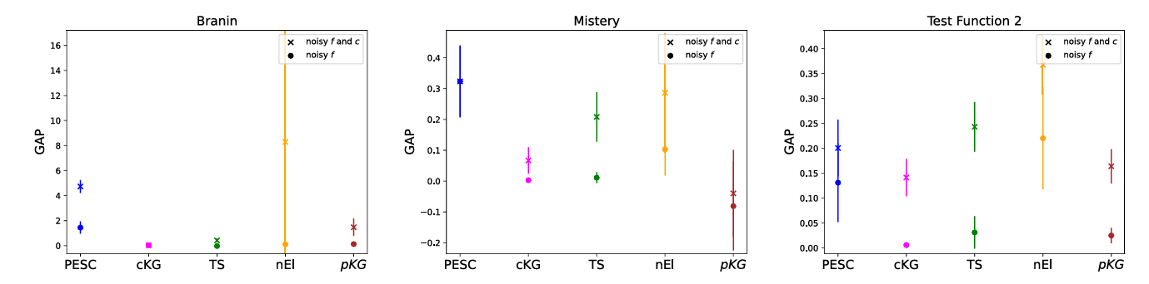
Noise Sensitivity Analysis

Slide 26
Neural Network Tuning on MNIST (TensorFlow)
1 ms latency constraint
9D design space
Layer size 8–4096

Slide 27
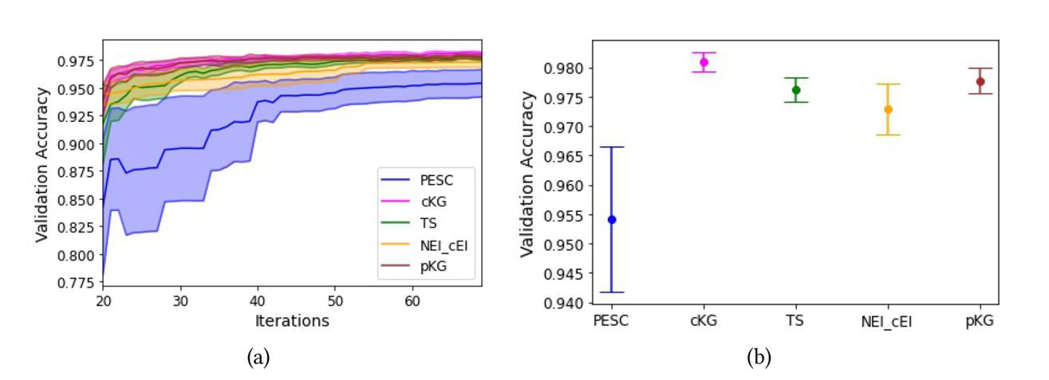
Tuning Results

Slide 28
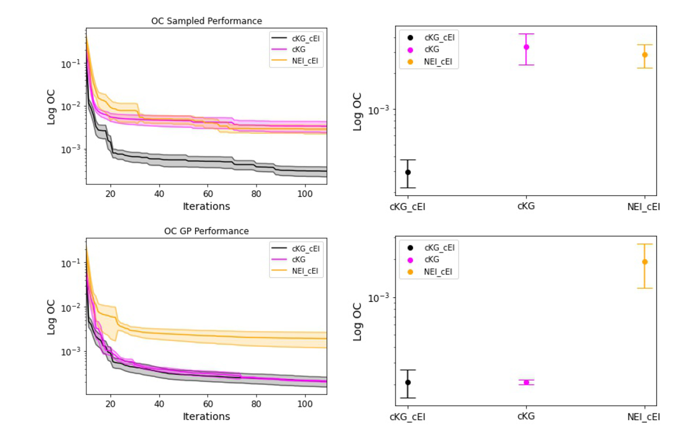
Effect of Final NEI/cEI Correction

Slide 29
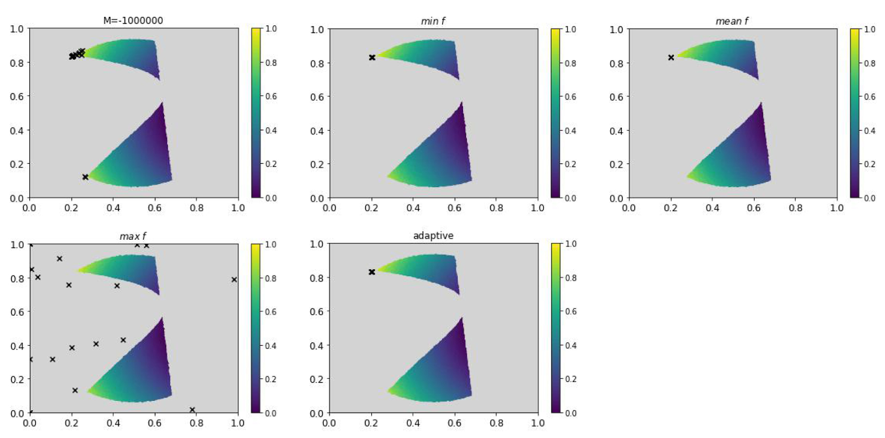
Impact of Penalty Parameter M -1

Slide 30
Impact of Penalty Parameter M - 2
M is very negative
Strong penalty for infeasible points
cKG becomes overly conservative, avoids boundary regions
Fails to explore areas near constraint limits
M is too large
Infeasible points treated as good as optimal ones
cKG ignores constraints completely
Recommends only infeasible solutions
Adaptive M
$$M=\min_{x}μ_{n}(x)$$
Always prefers feasible over infeasiblecKG ignores constraints completely
Still explores near constraint boundary

Slide 31
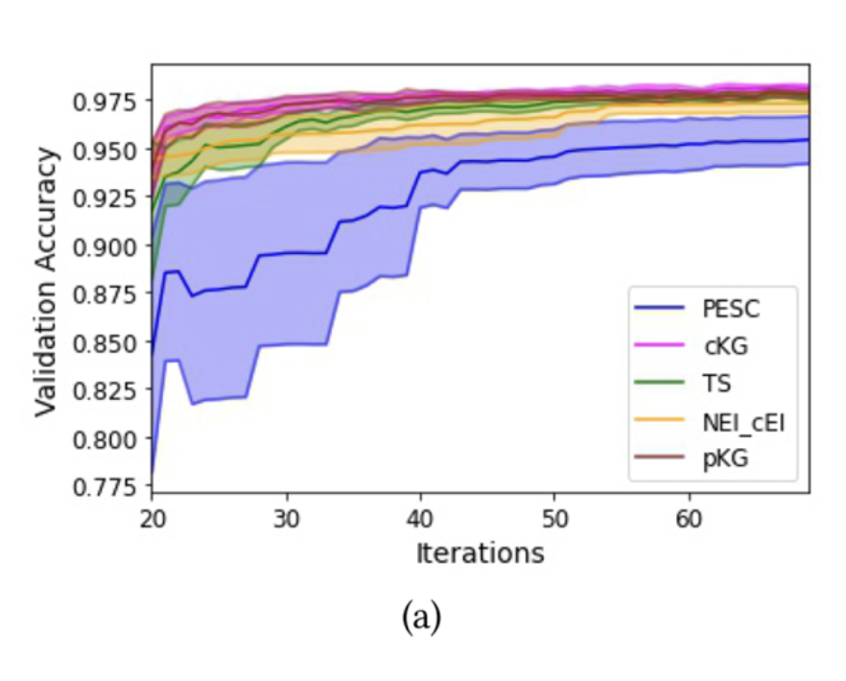
Conclusion & Overview
cKG quantifies the expected value of information gained from sampling a new point, considering both the objective and constraint models.
cKG can be efficiently computed by adapting the approach proposed in the work of Pearc eetal. [2020]
Proved that the algorithm will find the true optimum in the limit.
cKG consistently and significantly outperformed all benchmark algorithms especially on noisy settings

